Slide 1

Title of your Project
Electricity Billing System
Group members with Student ID
Shreyas Revankar-21107065
Swapnil Rathod- 21107064
Ankit Purohit-21107020
Meghraj Padwal- 21107025
Project Guide
Ms. Poonam Pangarkar

Slide 2
Contents
Introduction
Objectives
Features
Block Diagram
Output Screenshots

Slide 3
1. Introduction
The project is java based application that helps maintaining the bills and the payments.
This system is made to keep the records about the bills of the customers.
The customers can keep record of their own accounts and print a detailed statement for the same.
The system automates the conventional process of paying electricity bill by visiting the place.

Slide 4
2. Objectives
It keeps the complete information of the customers
It keeps the information of consuming unit of energy of current month.
The system calculates previous month’s bill, current month’s bill, tax amount, reading details, concession automatically.
The system has multiple electricity board payment option.
The customer can view bill report, Payment report and Balance details through online.

Slide 5
3. Feature
The system excludes the need of maintaining paper electricity bill as all the electricity bill records are managed electronically.
The system excludes manual bill calculation.
Users don’t have visit the office for bill payment.
There is no need of delivery boy for delivering bills to users place.
Thus, it saves human efforts and resources.
Due to growth in the number of customers handling of data and bills is done efficiently by automation of services.

Slide 6
4. Block Diagram/ Flow diagram
Start
Login Page
Customer ID
Clear
Password
Login
Print Report
Customer ID
Customer Name
Calculation
Month
Units

Slide 7
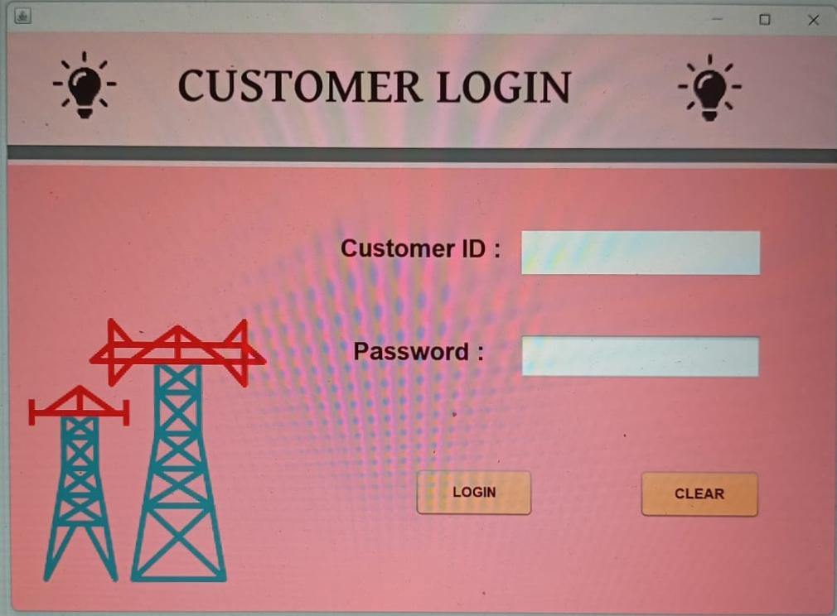
5. Output of Project
5. Output of Project

Slide 8
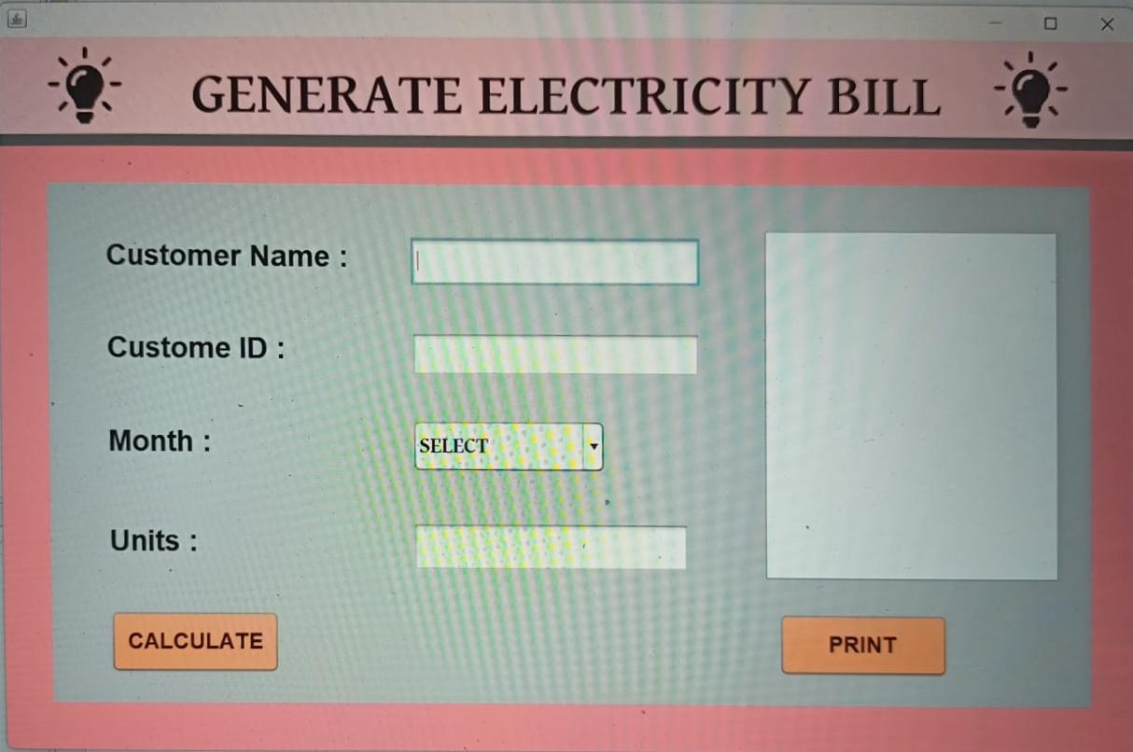
5. Output of Project

Slide 9
Thank You...!!

